Slide 1
Google App Store Data Analysis.

Slide 2
PROBLEM STATEMENT :-
Technology is an increasing need nowadays and used everywhere. One of the features of Technology is android. Which we all use in our daily life. Android is a mobile operating system based on a modified version of the Linux kernel and other open-source software, designed primarily for touchscreen mobile devices such as smartphones and tablets.
Do ETL: Extract-Transform-Load the dataset and find for me some information from this large data. This is a form of data mining. What all information can be achieved by mining this data would be brainstormed by the interns. Find key metrics and factors and show the meaningful relationships between attributes.
Do your own research and come up with your findings.

Slide 3
ABSTRACT :-
This project involves analyzing Google app Store data. Google Play is a digital distribution service operated and developed by Google Inc. It serves as the official app store for the Android operating system, allowing users to browse and download applications developed with the Android SDK and published through Google. Google Play also serves as a digital media store, offering music, books, movies, and television programs.

Slide 4
DATA SET :-
Contains various data on a set of apps in the google app store.
The data set is created due to the lack of public data set of google app store.
The dataset contains 33 categories of apps within it.

Slide 5
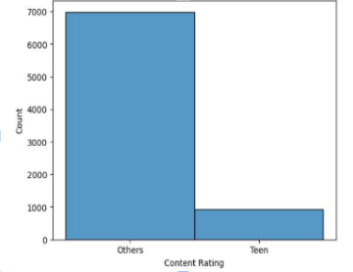
APP RATING BETWEEN TEENAGERS AND OTHER PEOPLE
The rating of teenagers is less than the rating of other people.
As show in the hist plot the rating of teenagers is 1000 and rating of the other people is near about to 7000.

Slide 6
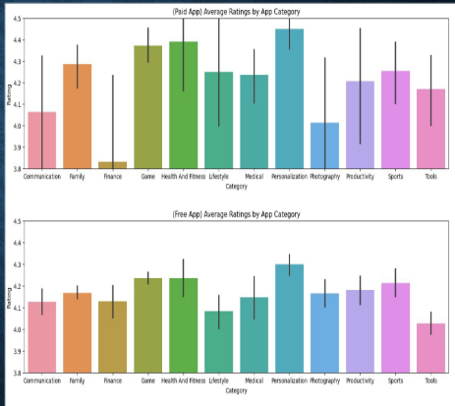
DIFFERENT APP CATEGORIES
The plot shows the different categories of apps.
There are different categories between the paid apps and free apps.

Slide 7
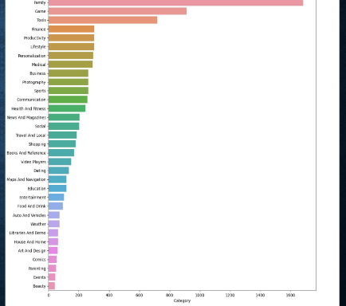
FAMOUS CATEGORIES OF APPS
The plot shows the different categories of apps in the dataset.

Slide 8
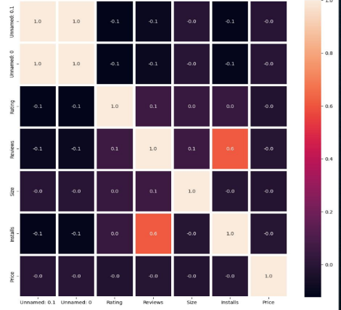
HEAT MAP
The heat map shows the relationship between the various parameters in the dataset.

Slide 9
THANK YOU.

